Slide 1
Problem no 3:
Daily a new News channel is coming in the market in some channel one news is shown whereas in other channels some other news is shown many a time same news sounds different on different news channel, recently many of the news channels have started with their online channels where facilities like e-newspapers is also provided. No of people use this e-newspaper but again reading a lengthy news is a time consuming task and sometimes boring, many times a complete page have only two or three lines of information. A standardized solution is needed where on a single platform where user can get all news depending on his/ her choice and also in summarized manner. Also a strategy is needed which will provide the user correct news and not a fake news.

Slide 2
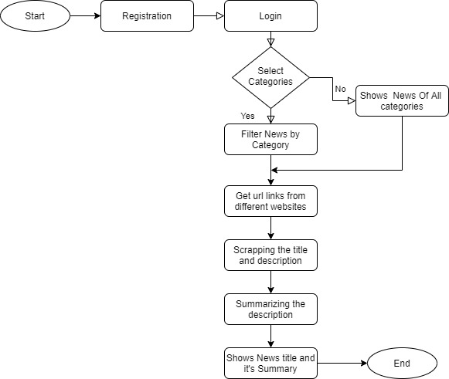
Flowchart

Slide 3
Libraries that has been used
Tkinter
newsapi
nltk
sumy

Slide 4
Approach
We have made a GUI application in which first you have to register and than login.
You can see the news feed based upon the categories.
Inside the code,
We have used api to get the current news based upon the categories.
We have used timesofindia, bbcnews to get the news for feed.
We got summary and title and related news.
News have been summarized using api.

Slide 5
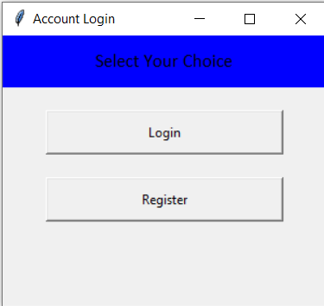
Login Page

Slide 6
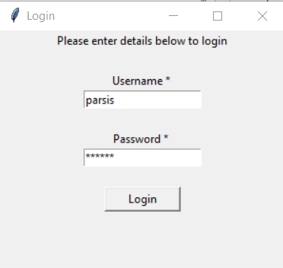
Login Page

Slide 7
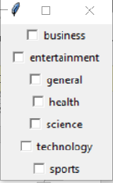
Choose category for which you want to read the news

Slide 8
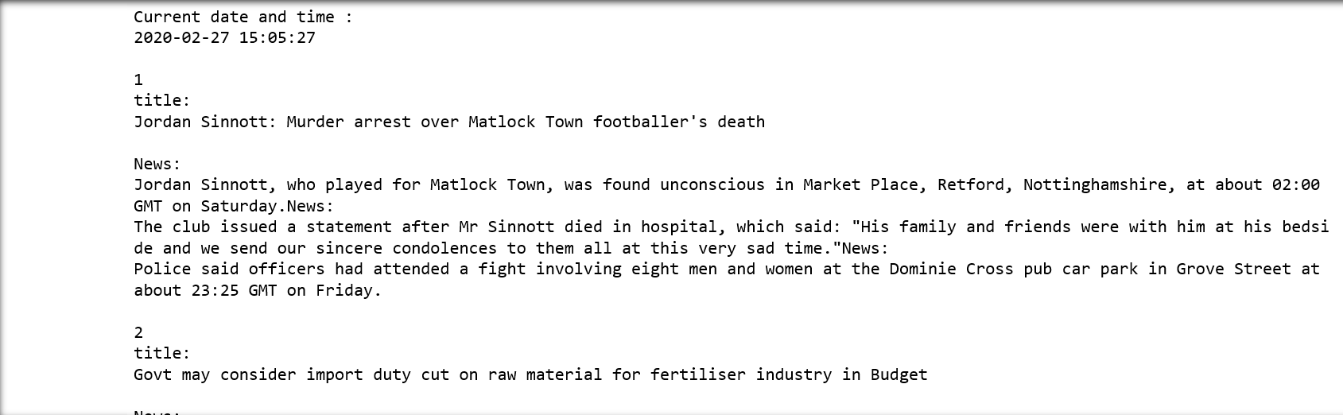
Output

Slide 9
Thank You…

